Slide 1
AR-SPICE Circuit Simulator
A Framework for Mixed Reality Aided Tools to Stimulate Learning Electric Circuits Fundamentals
Researchers: Jerry Fan and Hanliang (Chris) Ding
Supervisors: Associate Professor Waleed H Abdulla, Dr Kevin I-Kai Wang
Notes:
Self introductions here along with project title and aim of presentation

Slide 2
Content
Project overview
Background and motivation
System architecture
Breadboard input module
Component detection pipeline
Holographic input module
Augmented reality (AR) simulation environment
Limitations and difficulties
Future work and extensions
Demo/Video?

Slide 3
Electric Circuit Fundamentals
DC circuit theory and analysis
Resistive, capacitive and inductive circuits
DC analysis
First and second year university level electrical engineering courses
Series and parallel
Kirchoff’s voltage and current laws
Notes:
What do we consider as electric circuit fundamentals?
We wanted to focus on DC circuit theory and analysis for our research project, so this would include circuits with resistors, capacitors or inductors and any combination of those.
We would be looking at DC and transient analysis with DC. We would consider AC analysis in the future as an addition. This would be content appropriate for first and second year university level electrical engineering courses.
Some examples of the circuit problems we can attempt to address are series and parallel circuits with resistors and capacitors, and Kirchoff’s voltage and current laws

Slide 4
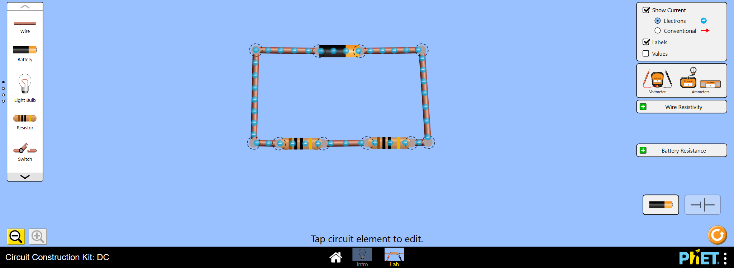
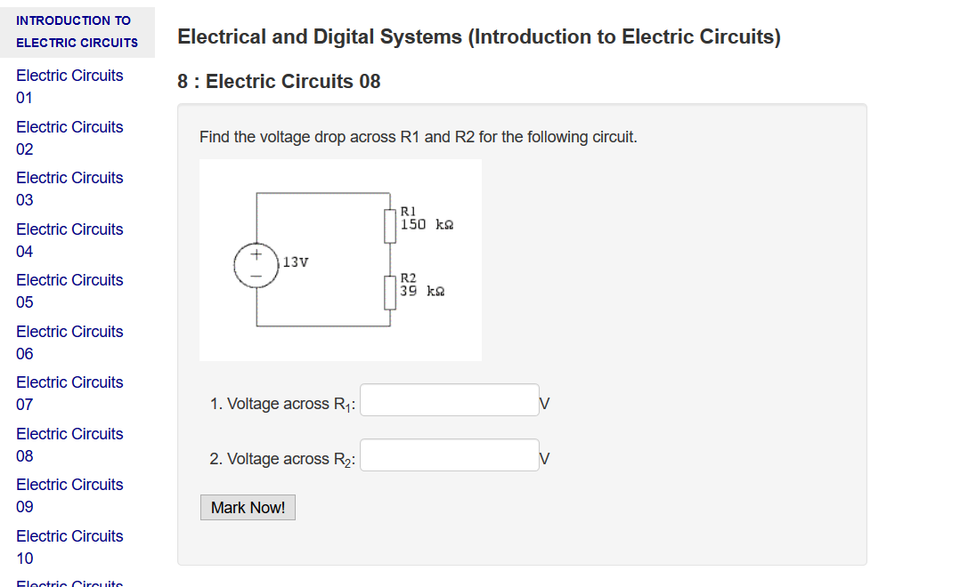
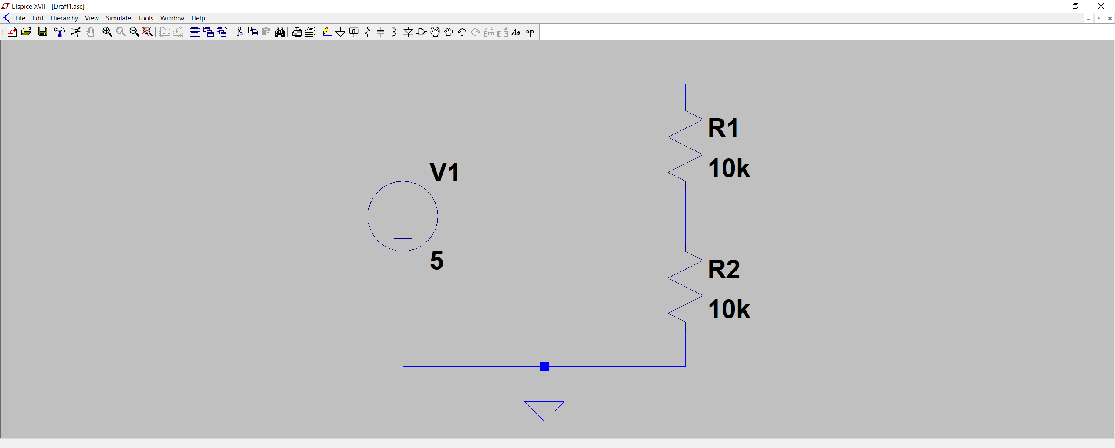
Existing Tools
Tools used in education of electric circuit fundamentals
PhET Circuit Construction Kit – University of Colorado Boulder, USA
OASIS assessment tool – University of Auckland, NZ
LTspice – Linear Technologies
Notes:
We looked at existing tools available to help with teaching electric circuit fundamentals. We found that the use of simulators were common in teaching of circuit theory.
OASIS is a bit different as an assessment tool rather than a simulator, but its resulting effects on students’ learning are quite similar – students have an increased motivation towards learning, in particular self-learning.

Slide 5
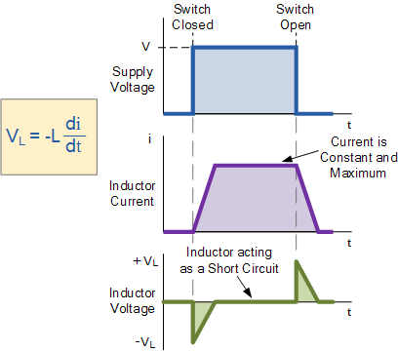
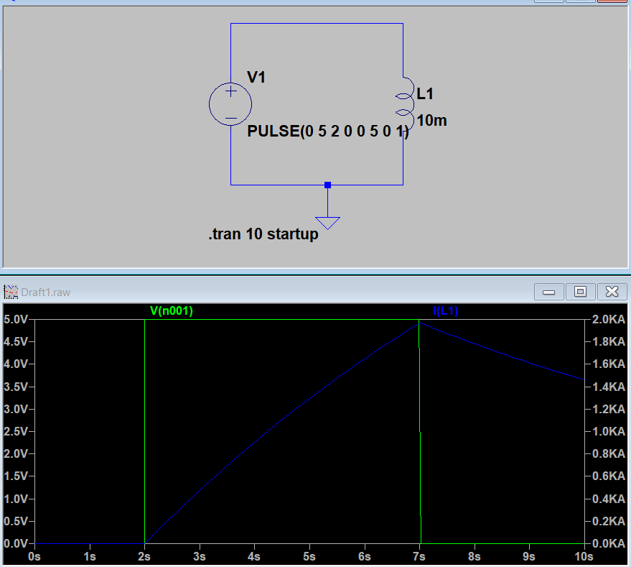
Challenges in Circuit Fundamentals Education
Student engagement in learning and developing a conceptual understanding
Student motivation in learning
Encouraging interest in electrical engineering
Student understanding of electric circuit concepts
Demonstrating differences between circuit theory, circuit simulation, and real circuits
[1]
[1]
‘Inductor and the Effects of Inductance on an Inductor’, Basic Electronics Tutorials, 14-Aug-2013. [Online]. Available: https://www.electronics-tutorials.ws/inductor/inductor.html. [Accessed: 03-Sep-2018].
Notes:
We also looked at the challenges in engineering education, including education in ECE in particular.
The challenges that are present include student motivation in learning – which also is related to encouraging interest in electrical engineering such that more students would want to join ECE. Student motivation naturally is linked to how individuals learn content and how that content is delivered, but in most cases, motivation to learn through lectures is quite low relatively when compared to practical laboratory sessions that are more interactive.
We also find that developing students understanding of electric circuit concepts is a area of interest. An example would be the concept of electrical potentials across components and the direction of current flow. We as ECE engineers know that direction of electric potential across components is in the reverse direction of current flow. But this is not necessarily an easy concept to explain.
Lastly, we have found that it is important to demonstrate differences between circuit theory, circuit simulation, and real circuits, as the results do not necessarily match up. As an example - in theory the circuit shown here would give a current graph like the following. However in simulation, the current does not behave in the same way, so what is it in reality?
In this case, it depends on the resistance of the wire and inductive coil as its resistance is significant to circuit behaviour as there are no other resistive components present.

Slide 6
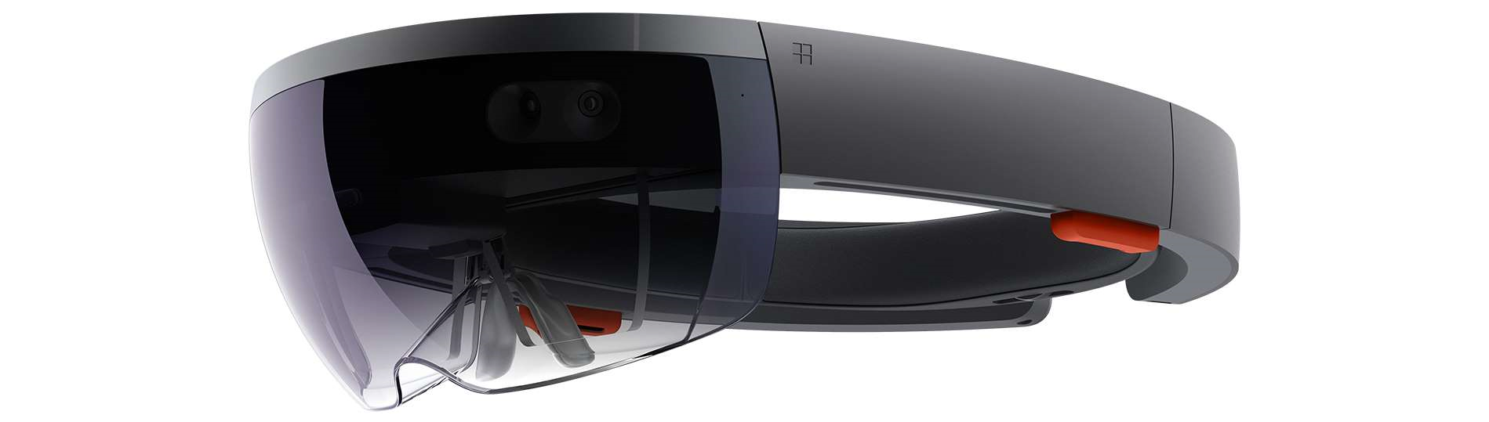
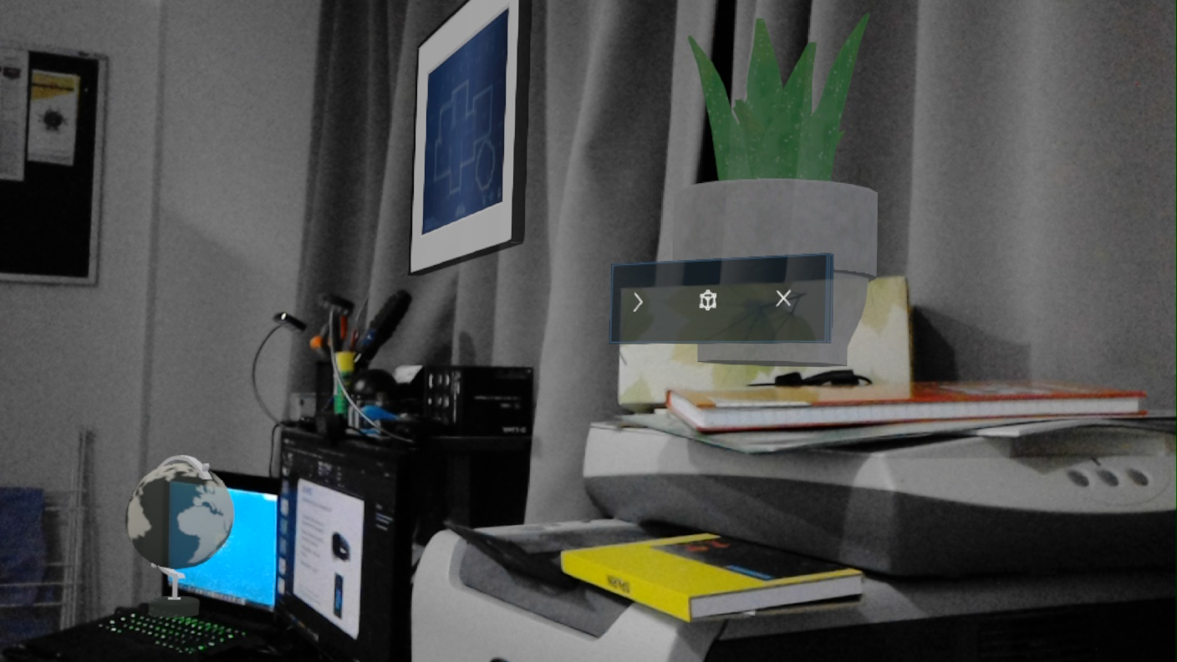
AR-SPICE
Augmented Reality (AR) circuit simulation tool
Our research proposes the use of an Augmented Reality (AR) application
Increased interactivity through AR to improve learning motivation
Perform circuit simulation in same environment as measurement
Developed on Microsoft HoloLens with Unity3D
[2]
[2]
‘Microsoft HoloLens’, Microsoft HoloLens, 2018. [Online]. Available: https://img-prod-cms-rt-microsoft-com.akamaized.net/cms/api/am/imageFileData/RE1GJzk?ver=8b59&q=60&m=6&h=600&w=1399&b=%23FFFFFFFF&l=f&o=t&aim=true. [Accessed: 01-Sep-2018].
Notes:
We proposed an augmented reality application to try to address the challenges in electric circuit fundamentals education
Following the examples of the existing tools, we have also created a simulation tool to help explain electric circuit concepts.
We chose the HoloLens as it allows us to provide increase interactivity through its Mixed Reality interface. The HoloLens's viewport is transparent which allows users to see into their environment as compared to virtual reality platforms. The interactions with holograms are three dimensional and integrated with the real world. This is shown in the bottom image where I placed holograms in my room’s environment.
In our application, we are able to place our simulation environment’s workspace alongside the circuit we are testing, and perform real measurements alongside simulations, easily comparing the results of both.
Our application is developed with the Unity3D toolkit, which allows us to rapidly develop a working environment for simulations, with objects representing placement tools that traditional applications such as Ltspice have (more on this later).

Slide 7
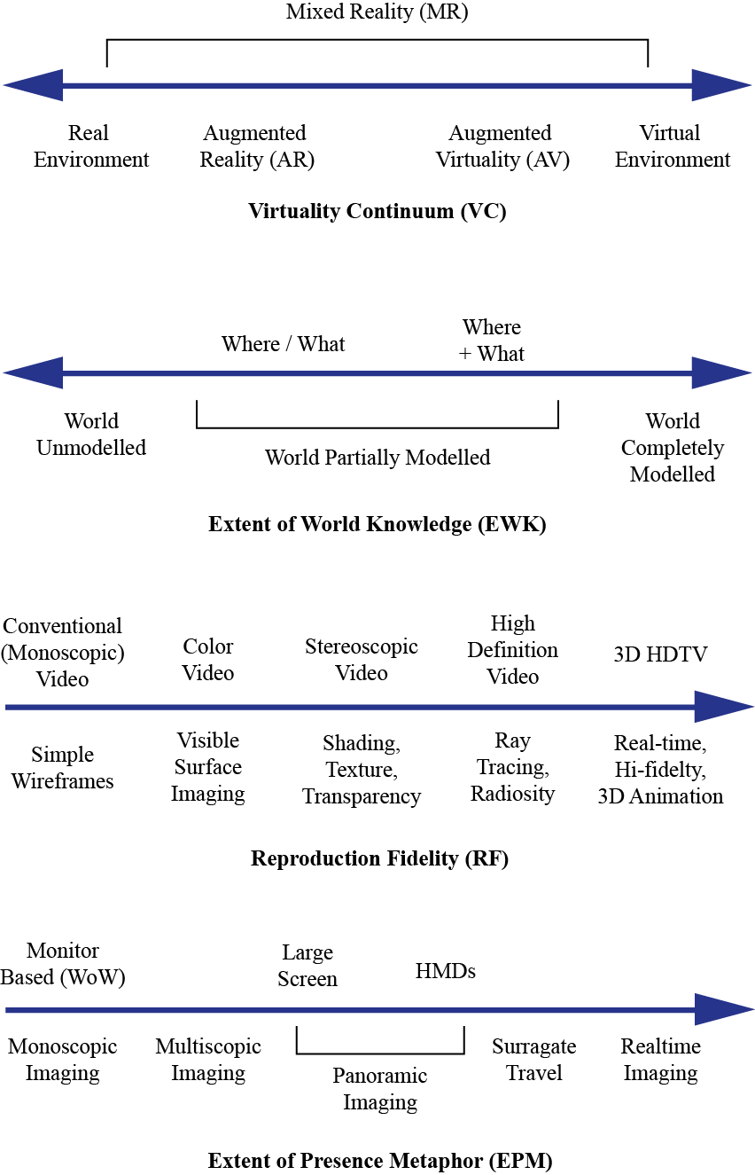
What is Augmented Reality?
A taxonomy of Mixed Reality (MR)
Taxonomy proposed by P. Milgram and F. Kishino in “A Taxonomy of Mixed Reality Visual Displays”
Mentioned in other published research

Slide 8
System Architecture
Overview of the system modules
Input
Breadboard
Holographic
Simulation
Notes:
This is a brief look of our application’s system architecture.
There are two input sources into the simulator, my work is on the breadboard scanner and the development of a detection pipeline for recognizing components on a breadboard.
My partner developed a holographic input interface so that circuits could be created and simulated using HoloLens input only.
The input modules can be combined to attach components on to existing circuits to test their response. Such as with an additional virtual resistor in parallel in a series circuit on the breadboard.

Slide 9
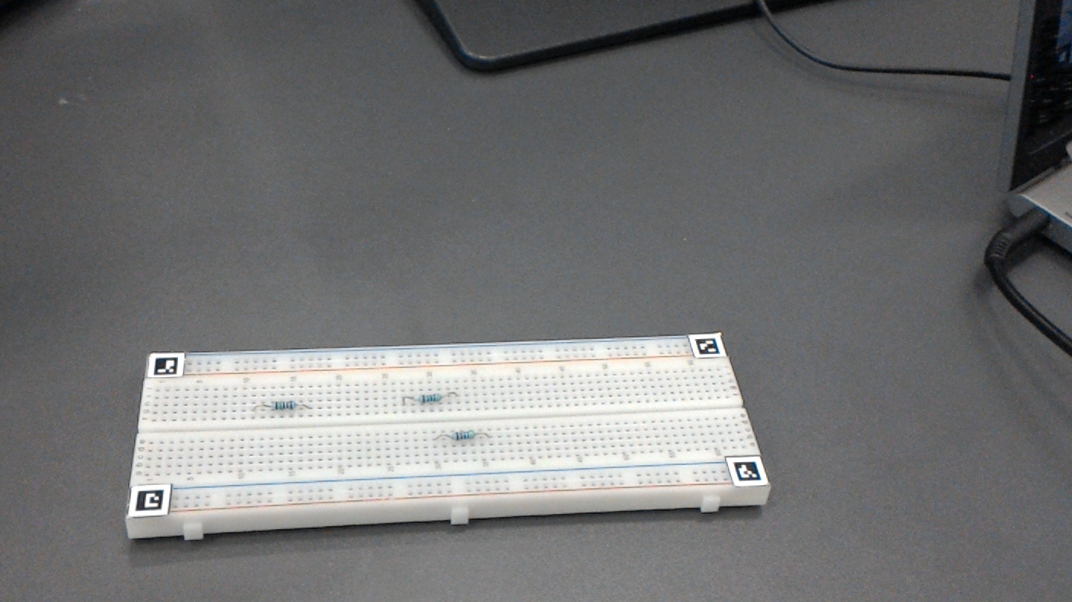
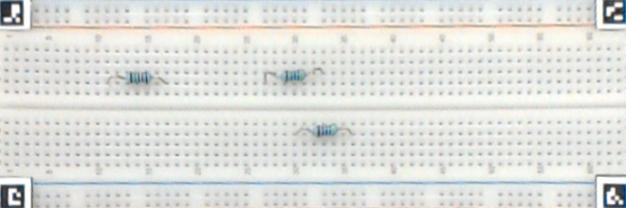
Breadboard Input Module
Circuit builder using real-world visual information
Top:
(3, 13)
(3, 28)
Bottom:
(1, 31)
Input image
Breadboard segmentation
Separation
Hole detection
Hole extraction
Hole classification
ArUco
Blob detection
Color thresholding /
Windows Machine Learning
Allows the use of a physical breadboard as an input device
Components are ‘scanned’ into the simulation
‘Scanned’ circuits immediately available in AR-SPICE
Can add additional holographic components
Achieved through computer vision with image segmentation and classification
Notes:
The breadboard input module takes frames captured from the HoloLen’s embedded camera and runs a detection algorithm to find components on a breadboard. The resulting output is a list of component positions. This allows a physical breadboard to be used as an input device. Components that are found are added to the simulation workspace. This process is done through computer vision, with an overview of the detection pipeline shown. Currently this module has a large amount of limitations as it is a prototype.

Slide 10
Breadboard Image Segmentation
Breaking down the image into useful chunks
ArUco markers helps in picking up the breadboard itself
Perspective transform creates a top down view
Resulting image is of a fixed size
Notes:
To perform component detection on the breadboard, the board must be first located in the input image. We use a markered detection algorithm with ArUco markers to perform the detection. Four ArUco markers and their pixel locations identify the top plane of the breadboard. This is then transformed to a top down view using image processing techniques.

Slide 11
Breadboard Image Segmentation
Breaking down the image into useful chunks
Component extraction simple task but not trivial
Assume breadboard holes are unfilled
Breadboard structure is regular – helps in using fixed pixel positions
Problem - camera lens distortion and physical distortions on the breadboard
Holes are roughly circular
Use blob detection and heuristics to pick up hole positioning
Notes:
The next step is to find the areas around the breadboard’s holes, as we need to identify what is inserted or covering each hole. We start by assuming all hole are unfilled and the breadboard structure is regular.
However a problem that is apparent is that there is camera lens distortion, along with physical distortion of the breadboard present in the camera frames, so we cannot just hard code in pixel coordinates – even with the same breadboard. The red line shown on the top image is straight and covers the left and right side holes on the breadboard, but does not cover the center. This indicates that the breadboard image is distorted.
Geven that the holes are roughly circular, a blob detection algorithm picks up the holes based on a description of the hole shape – this is known through trial and error.
An area around each hole is extracted for the classification stage. In cases where multiple holes or no hole is detected, heuristics are used to estimate the hole position based on the previously found holes in that row and column.

Slide 12
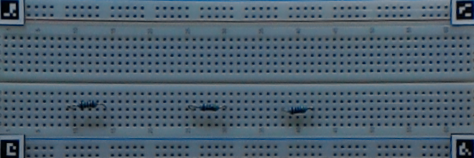
Breadboard Component Classification
Finding out what is what
Breadboard holes are seen as 11 x 11 pixel squares by the classifier
Classifier must determine if the area contains a component
Color thresholding sufficient to detect the body of a resistor in standard cases
A convolutional neural network (CNN) classifier was trained and tested
Significantly slower as a drop-in replacement but much more accurate
Notes:
The final classification steps uses the 11 x 11 pixel squares extracted and runs them through a classifier. We developed a classification algorithm that identifies green resistors such as those found in the ECE labs. This is done through color thresholding the square for green hued pixels. The classification algorithm can identify the body of the resistor but not the legs as the resolution is too low to accurately perform detection. We assume that the resistors are placed in a standard configuration.

Slide 13
Breadboard Component Classification
Finding out what is what
Hole
Resistor (top)
Breadboard holes are seen as 11 x 11 pixel squares by the classifier
Classifier must determine if the area contains a component
Color thresholding sufficient to detect the body of a resistor in standard cases
Notes:
The final classification steps uses the 11 x 11 pixel squares extracted and runs them through a classifier. We developed a classification algorithm that identifies green resistors such as those found in the ECE labs. This is done through color thresholding the square for green hued pixels. The classification algorithm can identify the body of the resistor but not the legs as the resolution is too low to accurately perform detection. We assume that the resistors are placed in a standard configuration.

Slide 14
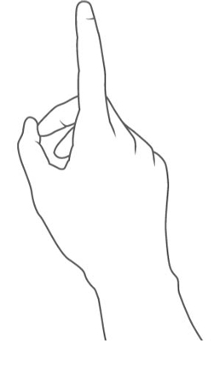
Holographic input module
Navigation and selection
User's gaze controls the location of the pointer (much like mouse movement)
User's 'air tap' gesture is used to select (much like mouse click)
Notes:
AR SPICE utilizes two main forms of user input
The first is the user's gaze which controls the location of the pointer, this is much like the movement of a mouse on a PC
The second are user gestures airtap is to click much like a mouse click

Slide 15
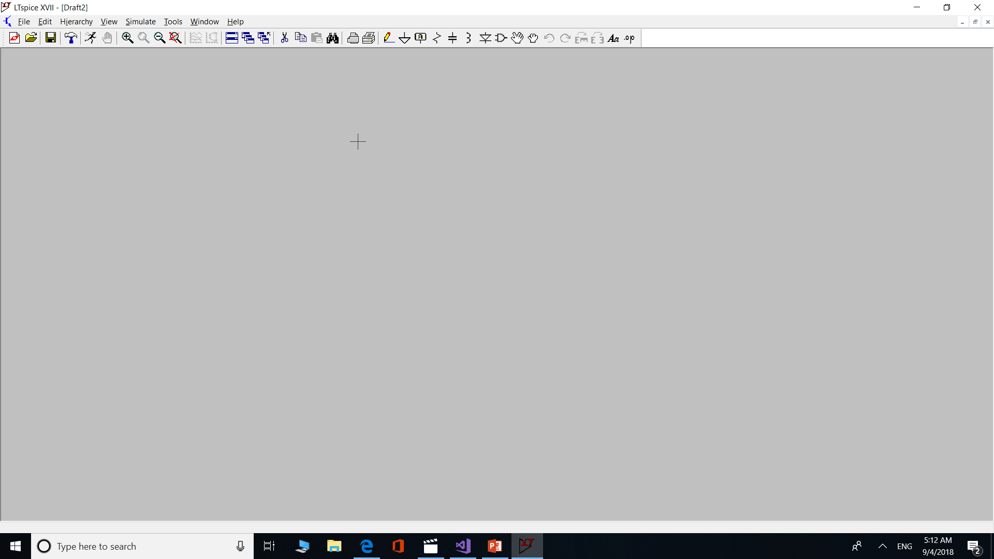
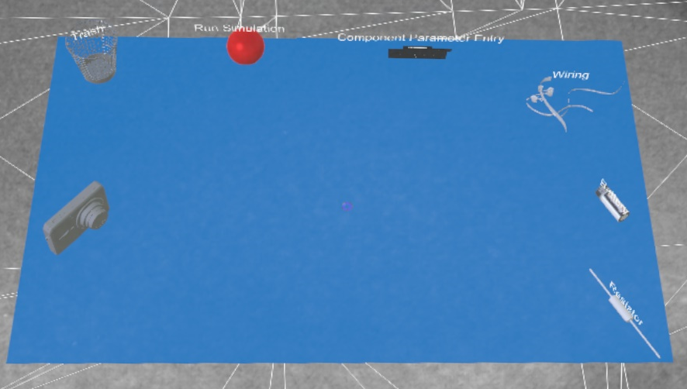
Holographic input module
Circuit builder using purely virtual components and user input
Similar to a traditional SPICE simulation
Resistor tool
Battery tool
Wiring tool
Value input tool
Simulation tool
Component disposal tool
Camera tool
Notes:
-We designed the circuit to imitate LTSpice software as it is already familiar for most electrical engineers
-Each tool in the picture corresponds to a functionality in the circuit simulation, some tool icons from LTSpice are shown next to their respective tools in AR SPICE
-The resistor and battery tools are for placing and generating resistors and voltage sources respectively
-The wiring tool is for connecting the components with a wire
-The value input tool is so that the user can click onto a component and enter the value
-The simulation tool simulates the circuit and displays the voltages at each of the nodes
-The camera tool is for scanning the actual breadboard.
-And the component disposal tool which is the trash can is for disposal of unwanted components

Slide 16
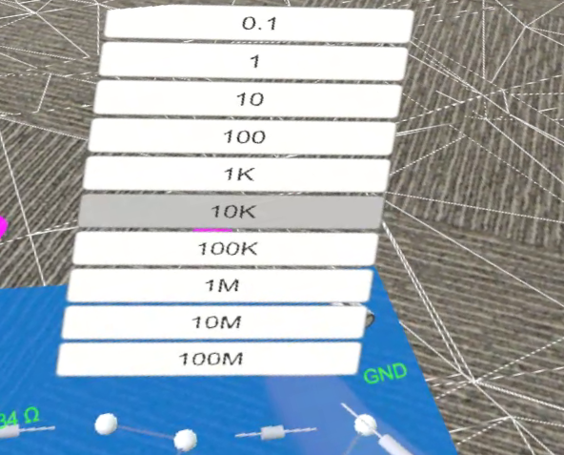
Holographic input module
Value entering
0
1
2
3
4
5
6
7
8
9
0
1
2
3
4
5
6
7
8
9
0.1
1
10
100
1K
10K
100K
1M
10M
100M
Keyboard input is tedious
Voice input is unreliable
Inspired from resistor bands
39 x 100K = 3.9M
Notes:
-One of the main challenges that we faced in designing the holographic input module is that entering values for the components is quite tedious as there is no actual keyboard to quickly enter in the values. The holographic system keyboard that is provided by the HoloLens requires you to look at each key on the keyboard and do an airtap for each key. This Is very time consuming and is not preferrable for the user.
-An alternative is to use voice input. But voice input can be very unreliable. The voice dictation can easily pick up the wrong value especially in a noisy environment so it was decided that voice would not be used for value entering.
-In the end we decided to settle with a method that is very similar to the color coding of resistor bands. When you select a particular resistor one of these panels will pop up. You can then choose to select one of these values, and the second will pop up. The last panel is for the multiplier of the resistor value. In this example on the slide, the highlighted buttons from each panel are selected so it's 3 and 9 which is 39 times 100k so the resistor's value would be 3.9Mega Ohms. This is far more reliable than voice input and requires a few less clicks than keyboard input. This also removes the unnecessary key from the keyboard which speeds up the process.

Slide 17
Augmented reality (AR) simulation environment
Component Graph
Graph.Graph Object
Each component is in a vertex object
Vertex object contains
Connected nets/terminals/nodes
Component value
Unity3D GameObject
Graph object contains
List of vertices
R1
Nodes: {1, 2}
Value: 100k Ω
DC
Nodes: {1, GND}
Value:5V
Graph.Vertex Object
Graph.Vertex Object
Node1
100k
Node2
120k
5V
R3
Nodes: {1, GND}
Value: 120k Ω
R2
Nodes: {2, GND}
Value: 120k Ω
100k
Graph.Vertex Object
Graph.Vertex Object
Circuit from slide 3
Notes:
The component graph is a graph like data structure that contains all relevant information so that an actual circuit schematic can be captured inside the graph.
- Each vertex contains the nodes that are connected to the specific component embedded inside so that the component can relate to the rest of the circuit.
- It also contains the value of the component that is contained inside the vertex as it's needed for simulation purposes
- Lastly it contains the Unity 3D GameObject which is the hologram you see in the HoloLens so that the values can be displayed near these componets.

Slide 18
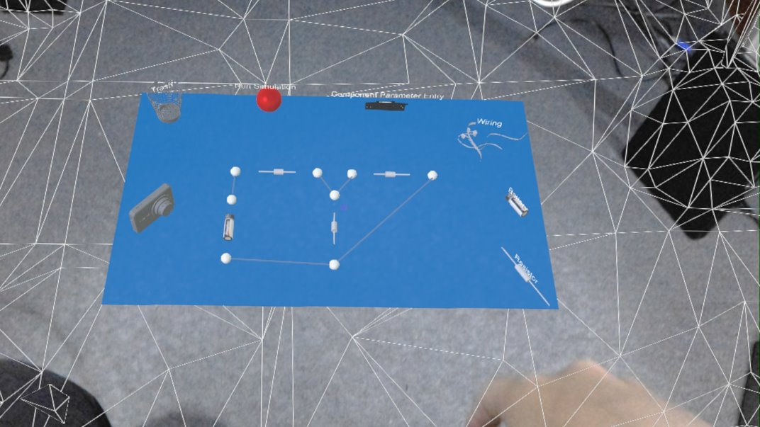
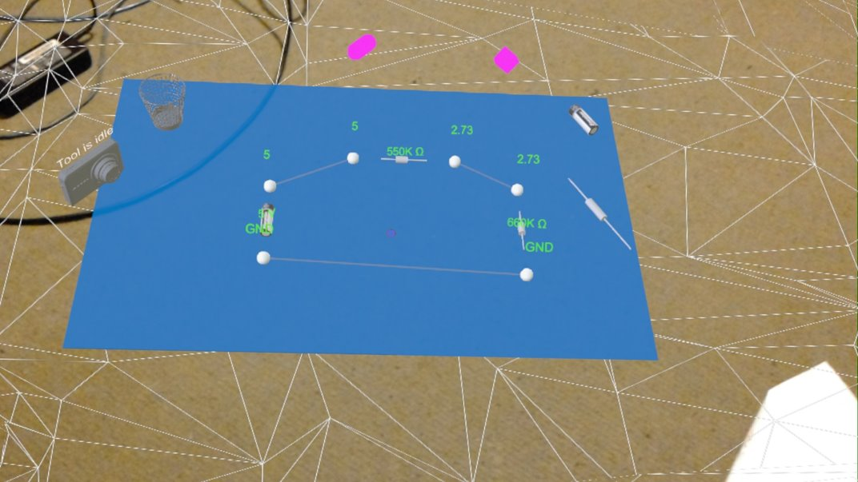
Augmented reality (AR) simulation environment
Circuit simulations
SpiceSharp
C# spice simulations library
Free to use
Circuit correctness checks
DC and Transient simulations
Netlist
List of components with values and connected nodes
Graph
Netlist
SpiceSharp.Circuit
Vertex Graph
SpiceSharp.Simulation
Run()
Virtual Circuit Value Display
Simulate
Notes:
The SpiceSharp library is a C# spice simulation library. It is open source and it's the only simulation library we could find. It provides circuit correctness checks to make sure the user has made a valid circuit. If the user for example accidentally created an open circuit or one of the resistors had no values then this would pick it up and throw an exception.
The SpiceSharp circuit takes a netlist as input which can be generated from the component graph. The netlist is just a list of components with values and connected nodes which is essential for spice simulations. It is used as a text representation of a circuit. The SpiceSharp's circuit object is then passed into a Simulation object as shown and when the run() function is called the holographic circuit as shown is updated with the node values.
The bottom two images show an unsimulated virtual circuit on the left and a simulated circuit on the right

Slide 19
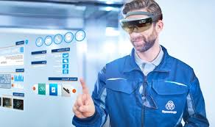
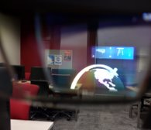
Limitations
Limitations imposed by the hardware
misleading advertising for HoloLens
Camera resolution too low to detect resistor bands/values​
HoloLens does not provide hand tracking and pointing as many people would expect from AR​
HoloLens field of vision is small
Small field of vision for Holograms
Notes:
Next I will discuss some of the limitations and difficulties we faced
- First, the original idea was for AR SPICE was to automatically detect component values. But this was quickly abandoned as the resolution of the cameras proved to be too low for the color bands to be picked up. As you might have noticed some of the screen shots we took from the HoloLens are slightly pixelated. This is also because of the HoloLens' camera resolution.
- Another problem is that people expect to point or interact with holograms with their hands. This is not the case. The HoloLens only supports a few hand gestures and does not trash your hand with respect to the Holograms so you cannot interact with the holograms that way. As shown by the top picture the man is seemingly pressing the holograms as if they were touchscreens. This is very misleading as all the HoloLens is detecting is his tap. The movement of the cursor is still dictated by his gaze.
- Another common dissatisfaction with the HoloLens is the small field of vision the Holograms are able to render in. As you can see with the bottom picture which is taken through the hololens viewport.
- But these limitations will be eventually mitigated if the HoloLens continues to be developed so we can hope that in the future all these limitations will be gone.

Slide 20
Difficulties and Challenges
Various problems we faced
Limited timeframe
Limited compatible software libraries available for HoloLens – ported several and wrote C++/CLI interop for C++ libraries
Overlaying information on real world objects requires significant work on detection pipeline and UI
Only resistors are detected
Notes:
Partially ported two algorithm and data structure libraries for the Unity platform, along with writing a library allowing Unity to access the C++ OpenCV library functions that were needed – This caused additional time to be spent on the tooling rather than the research
The information overlay on to the breadboard would be the next item to be worked on once the detection became stable
Only resistors are able to be detected with the current prototype

Slide 21
Future Work and Extensions
What we can do next and what is possible
Interface will get easier to use when HoloLens releases more updates​
Component value detection with a higher resolution camera​
Automatic fault detection​
Show current flow in simulation​
More components such as capacitors, transistors etc.​
User studies
Information overlay on components
Notes:
- As discussed before the Interface will be a lot easier to use when the HoloLens start supporting hand tracking so the user will get a more immersive experience.
- With a higher resolution camera in the future we will be able to implement automatic component value detection and therefore it will have a better experience for the user and they will be less prone to make mistakes as they won't need to manually enter the component values.
- This application can also be used to detect faults in the breadboard circuit so that users don't have to spend hours trying to debug their circuits. Debugging is a good learning experience but if they really get stuck then AR SPICE can provide some support.
- Showing current flow is implemented in many simulation software as of today. This is a good way to add some intuition into the AR Spice application
- This is more of a time issue
- In the future we would like to conduct user studies which would validate whether

Slide 22
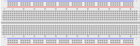
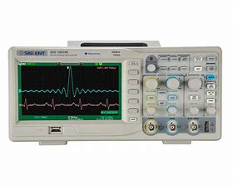
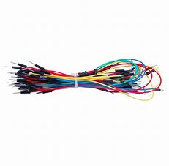


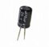

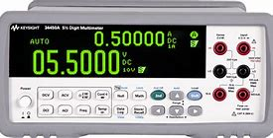
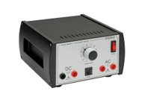
Challenges in Circuit Fundamentals Education
Lack of resources
Circuit Building
Spice Simulations
Verification and Testing
+
+
+

Slide 23
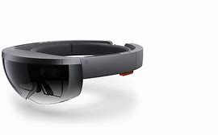

AR-SPICE
All in one application for circuit building, simulations and testing
Spice Simulations
AR-SPICE
Multimeter
Oscilloscope
Power Supply
Wires
Notes:
Our end product would be a immersive and interactive AR application that allows students to have a higher motivation in getting some hands on experience with breadboarding. Which would increase they understanding of circuit fundamentals.

